Slide 1

DIGITAL CODE LOCK USING ARDUINO
JNTUH COLLEGE OF ENGINEERING SULTHANPUR
BATCH.NO : 6
CH.SUMANTH 13SS1A0410
S.MAHITHA 14SS1A0404
M.SOUJANYA 13SS1A0434

Slide 2
Objectives
To free users from the worry of remembering
keys
To design a keyless door entry by using electronic digital
lock code
To avoid any crimes especially stealing activities

Slide 3
Introduction
Digital Code Lock using Arduino is a basic control system
with an ability that allows any user having valid password
to use the system with simple password protection
Password can be changed by the user. The circuit is highly
suitable as a digital lock with security option.

Slide 4
Motivation
Conventional locks are heavy and do not offer the desired
protection as they can be easily broken down by using
some tools.
Therefore security breaching problems are associated
with mechanical locks so usage of electronic security
system became necessary

Slide 5
Tools Used
Arduino Uno(ATmega 328)
4x4 Matrix Keypad
16x2 LCD
5V Stepper Motor
Arduino IDE

Slide 6
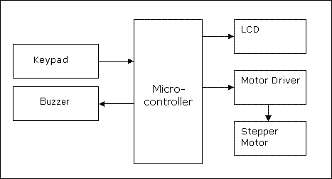
Block Diagram
ATmega 328

Slide 7
Methodology
Keypad is an input device which is used to enter the
password.
LCD and buzzer are the indicating devices for alarming
and displaying information.
The stepper motor controls the door locking and
unlocking
Arduino reads data when ever someone enters password
compares it with stored password

Slide 8
Arduino
Arduino is an open-source physical computing platform
based on a simple i/o board also including an Integrated
Development Environment (IDE) for programming
Arduino is based on the ATmega 328 microcontroller.
It can run standalone from a computer and it has memory
and it can work with both Digital and Analog electronic
signals.

Slide 9
Matrix Keypad
This is a 16 button keypad which provides user interface
component for Arduino project
This keypad is interfaced by using 8 pins which are used
to access these 16 buttons
When ever a button is pressed a pair of pins will give
information that which button is pressed

Slide 10
16x2 LCD
16x2 LCD means max 16 characters per line can be
displayed and there are 2 lines
These modules consists of 5x7 or 5x8 dot matrices to
display each letter
It is available in 16 pin package with back light and
contrast adjustment function

Slide 11
Stepper Motor
The uni polar stepper motor will have five or six wires
and four coils the connections to these coils is used as
power connection
This stepper motor needs a motor driver in orders to
work

Slide 12
Conclusion
The project can be used to automate the door locking
process, so the user need not to carry the door lock keys
along with him, he can just remember the password and
use it later to open the door
Digital code lock is totally based on the Arduino,
compared to other microcontrollers it requires less
hard ware
As the Arduino has digital and analog pins it does not
require any A/D,D/A converters

Slide 13
Future Development
We can send this data to a remote location using
internet.
We can implement other related modules like
fire sensor, wind sensor.

Slide 14
References
Arduino Programming Notebook – Brian W Evans
First edition, Aug 2007
http://instructables.com
http://arduino.cc/tutorial
Getting started with Arduino, Mazzimo Banzi(co-founder)
2nd edition 2011, O’Reilly

Slide 15
Thank you

